Slide 1

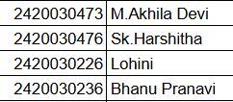

COMPILER DESIGN (24CS2235F)
REVIEW – 1
Syntax Error Detection and Correction Tool
Team No-
Roll No Name
Department of Computer Science and Engineering
KONERU LAKSHMAIAH EDUCATION FOUNDATION

Slide 2
OUTLINE
Introduction
Objectives
Literature Survey
Proposed Method
Work Flow
Conclusion

Slide 3
Introduction
The Syntax Error Detection and Correction Tool is a compiler-based application designed to detect, analyse, and suggest corrections for syntax errors in source code. Syntax errors such as missing semicolons, unmatched brackets, incorrect keywords, and invalid expressions can make programming difficult, particularly for beginners. The proposed tool provides an automated approach to identifying these errors and presenting clear error messages along with possible corrections.
The system demonstrates important concepts of Compiler Design, including lexical analysis, tokenization, syntax analysis, parsing, and error recovery. The source code is first converted into tokens by the lexical analyser, after which the parser checks the tokens according to the grammar rules of the programming language.

Slide 4
Objectives
To detect common syntax errors such as missing semicolons, unmatched brackets, incorrect keywords, and invalid expressions in source code.
To identify and display the location and type of errors and provide suitable correction suggestions to help users fix them quickly.
To implement basic error recovery so that the tool can continue analysing the remaining source code after detecting an error.
To provide a simple and user-friendly tool that helps beginners understand syntax analysis, parsing, and error handling.
To improve the clarity of compiler error messages by presenting errors in a simple and understandable format.
To demonstrate key Compiler Design concepts such as lexical analysis, tokenization, syntax analysis, parsing, and error recovery through a practical application

Slide 5
Literature Survey
Syntax error detection is an important part of compiler design. Traditional compilers use lexical analysers and syntax analysers to identify invalid tokens and violations of grammar rules. Lexical analysis divides source code into meaningful tokens, while syntax analysis checks whether these tokens follow the grammar of the programming language.
Compiler Design techniques such as parsing and error recovery have been widely used to improve the handling of incorrect source programs. Error recovery allows a compiler to continue analysing the remaining source code after detecting an error instead of stopping immediately.
Existing programming environments generally display compiler-generated error messages when syntax errors occur. However, these messages may not always be easy for beginners to understand. The proposed project focuses on providing a simple interface that not only detects syntax errors but also displays their location, type, and possible correction. The project therefore combines lexical analysis, tokenization, parsing, and basic error recovery into a user-friendly educational tool. These concepts are also the core compiler concepts identified in the project's abstract.

Slide 6
Proposed Method
The proposed system follows a sequence of compiler-based processing steps:
Source Code → Lexical Analysis → Tokenization → Syntax Analysis → Error Detection → Error Recovery → Correction Suggestion → Result
Step 1: Source Code Input
The user provides the source code that needs to be checked.
Step 2: Lexical Analysis
The lexical analyser reads the source code and converts it into a sequence of tokens such as keywords, identifiers, operators, literals, and symbols.
Step 3: Syntax Analysis
The generated tokens are passed to the parser. The parser checks whether the sequence of tokens follows the grammar rules of the selected programming language.

Slide 7
Proposed Method
Step 4: Error Detection
The system identifies common syntax errors such as:
Missing semicolons , Unmatched brackets or parentheses , Incorrect keywords , Invalid expressions and Incorrect token sequences
Step 5: Error Analysis and Correction
For every detected error, the system provides its location, error type, and a possible correction. This makes the error easier for the user to understand and fix.
Step 6: Error Recovery
Basic error recovery techniques are applied so that the system can continue analysing the remaining source code even after encountering an error.
Step 7: Display Results
The final output displays the detected syntax errors along with suitable correction suggestions in a clear and user-friendly format.

Slide 8
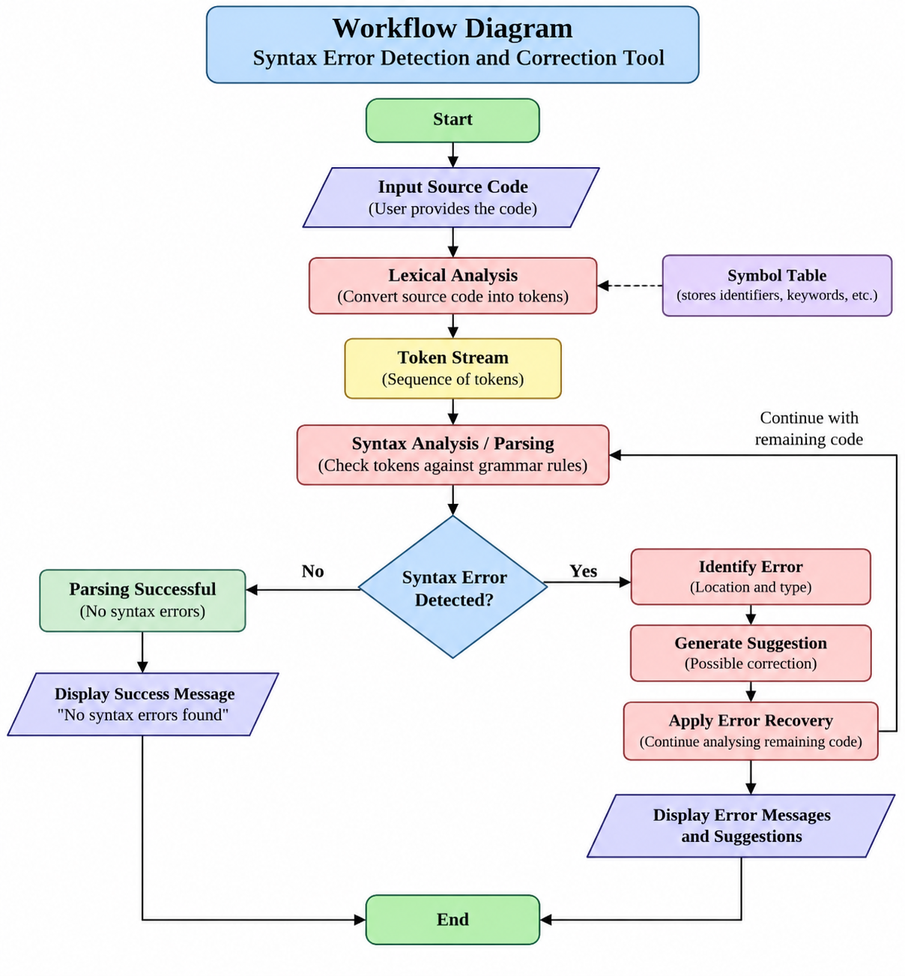
Work Flow

Slide 9
Conclusion
The Syntax Error Detection and Correction Tool provides a practical demonstration of important Compiler Design concepts. By combining lexical analysis, tokenization, syntax analysis, parsing, and error recovery, the system can identify common syntax errors and provide possible corrections.
The tool is particularly useful for beginners because it presents errors in a simple and understandable manner. It can help users learn programming grammar, understand how parsers work, and become familiar with the way compilers detect and handle syntax errors. Overall, the project aims to make the process of identifying and correcting common programming errors more efficient and user-friendly.

Slide 10
THANK YOU

